Slide 2
“A WALK ON THE CLOUDS”
This town situated on the top of the region, has the advantage to have the purest air of Madrid’ s Community and the quietness of nowhere else. You can see this view from Peña del Águila (1440m) , at only 15 minutes walk from Santa María de la Alameda town center.

Slide 3
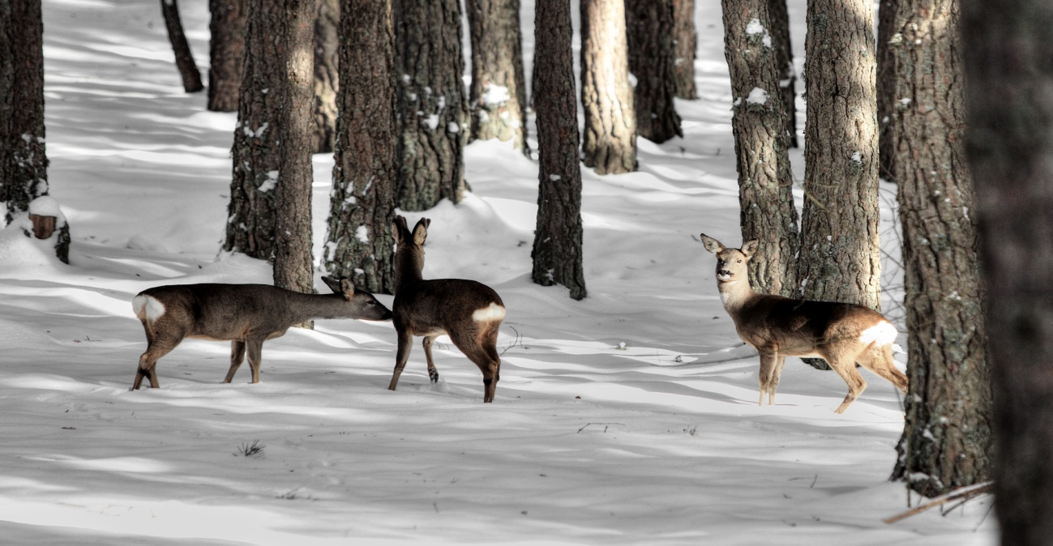
NATURE
With only one hundred inhabitants, it has really amazing natural spots.
Some spaces are so virgin because
not many people walk across them.
We can only see hunters in some hunting
areas specially reserved for them.

Slide 4
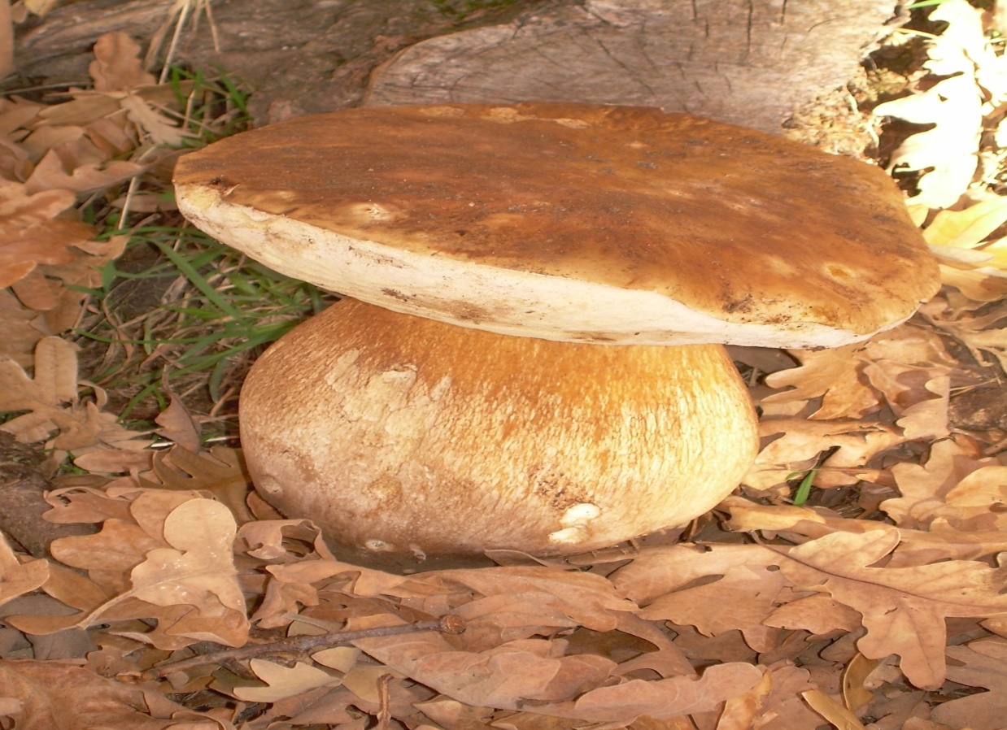
TREASURES IN AUTUMN
People who love collecting mushrooms have a paradise here in autumn. We can specially
mention:boletus, thistle mushrooms and “lactarious deliciosus”.

Slide 5
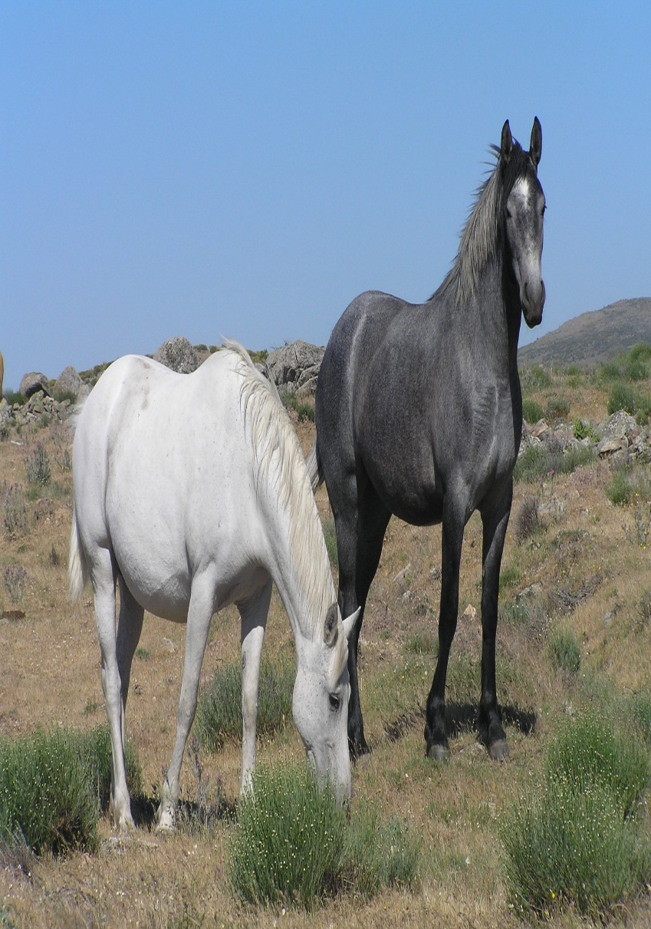
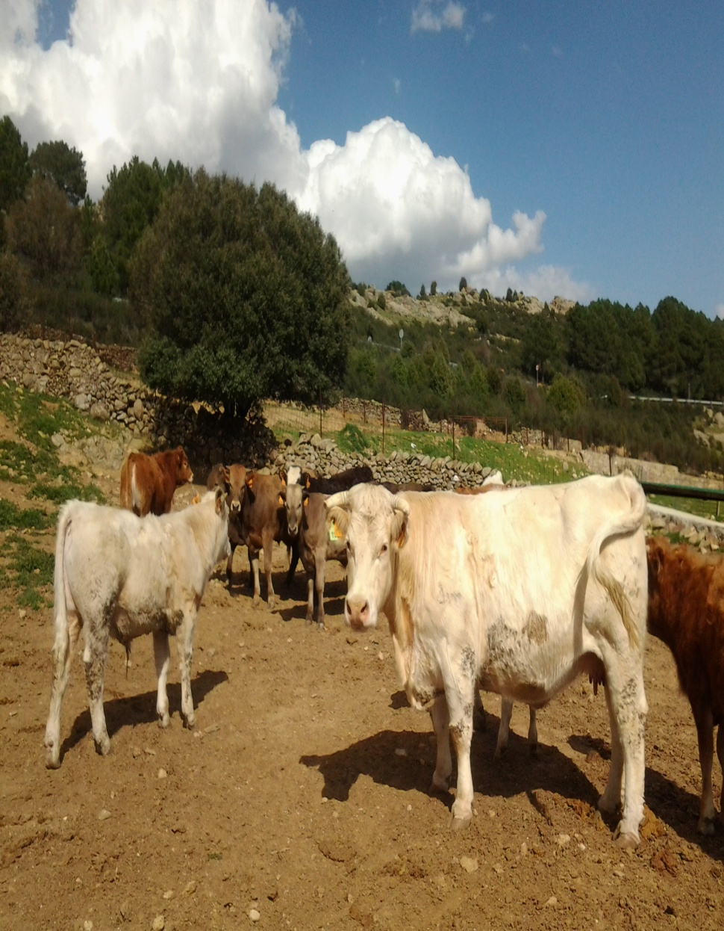
ANIMALS
Nowadays Santa Maria de la Alameda counts with more than 60
farm enterprises which give richness to the local neighborhood.

Slide 6
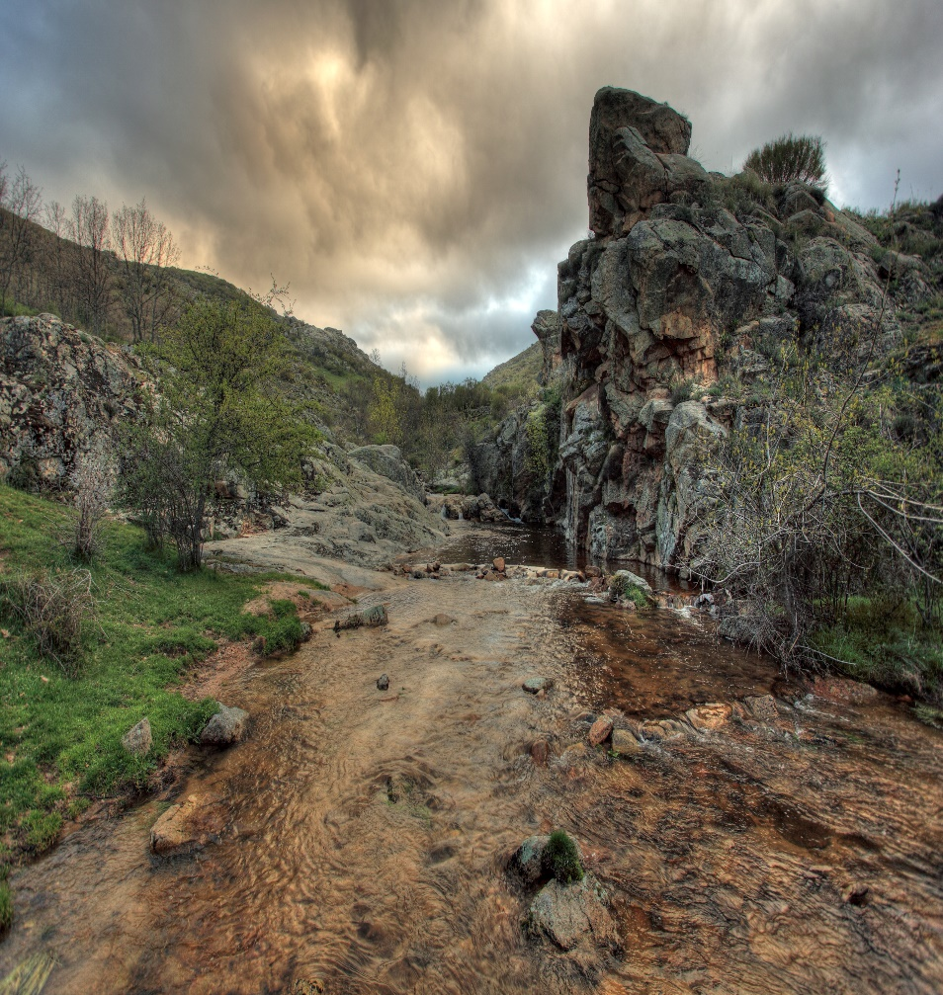
RIVERS
The rivers Aceña and Cofio design a wonderful landscape with its river falls and
its river gorges that give freshness and variety to the green areas.

Slide 7
LEISURE
It is a marvellous area to practise sports like
cycling because of its vast territory.
During the summer, population
increases. People who are used to living
in a very quiet town need to share this private
paradise with the new neighbours…
but only for a while…because it is too special.

Slide 8
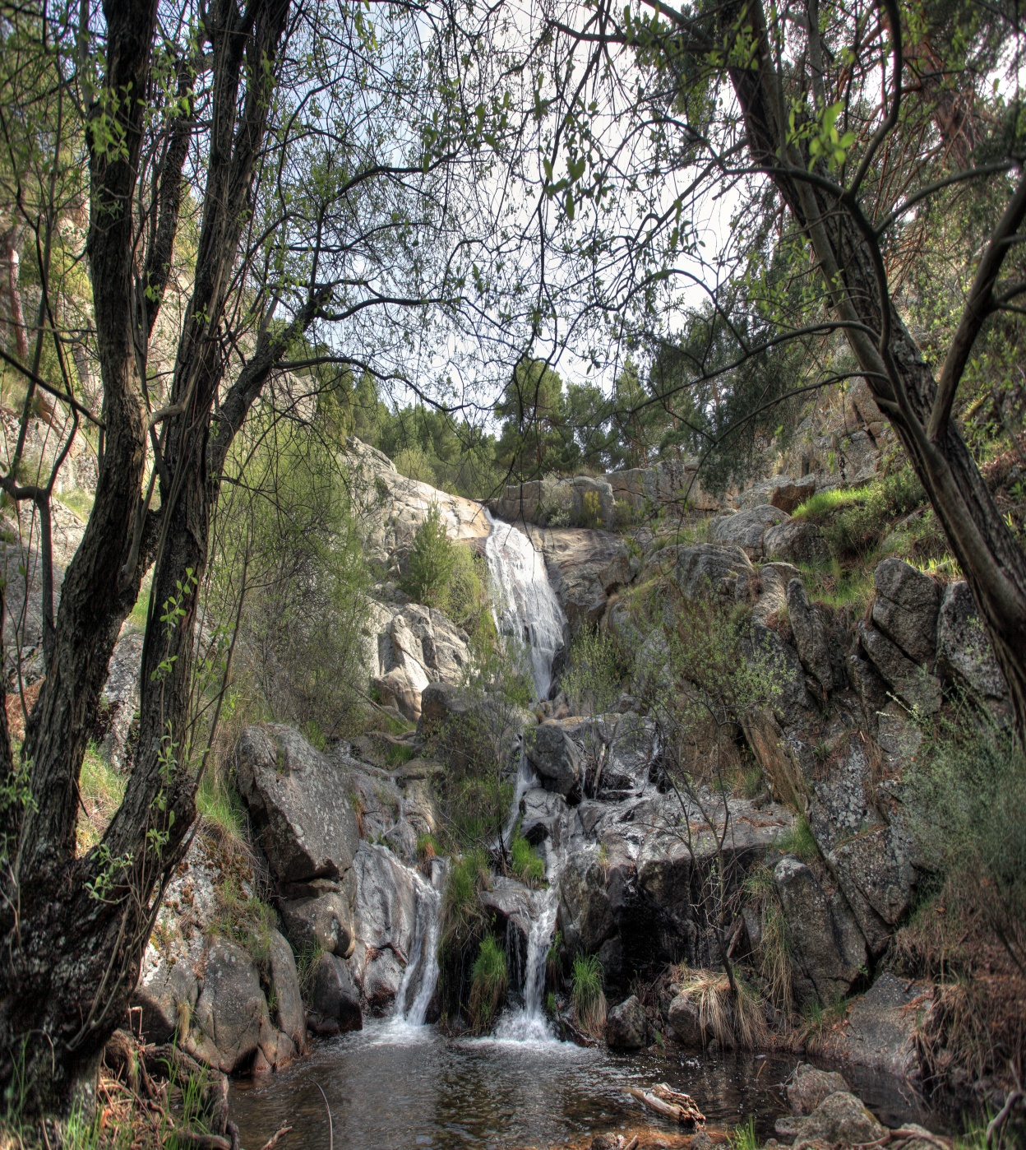
NICE VIEWS
Words are not necessary
to complete these pictures.

Slide 9
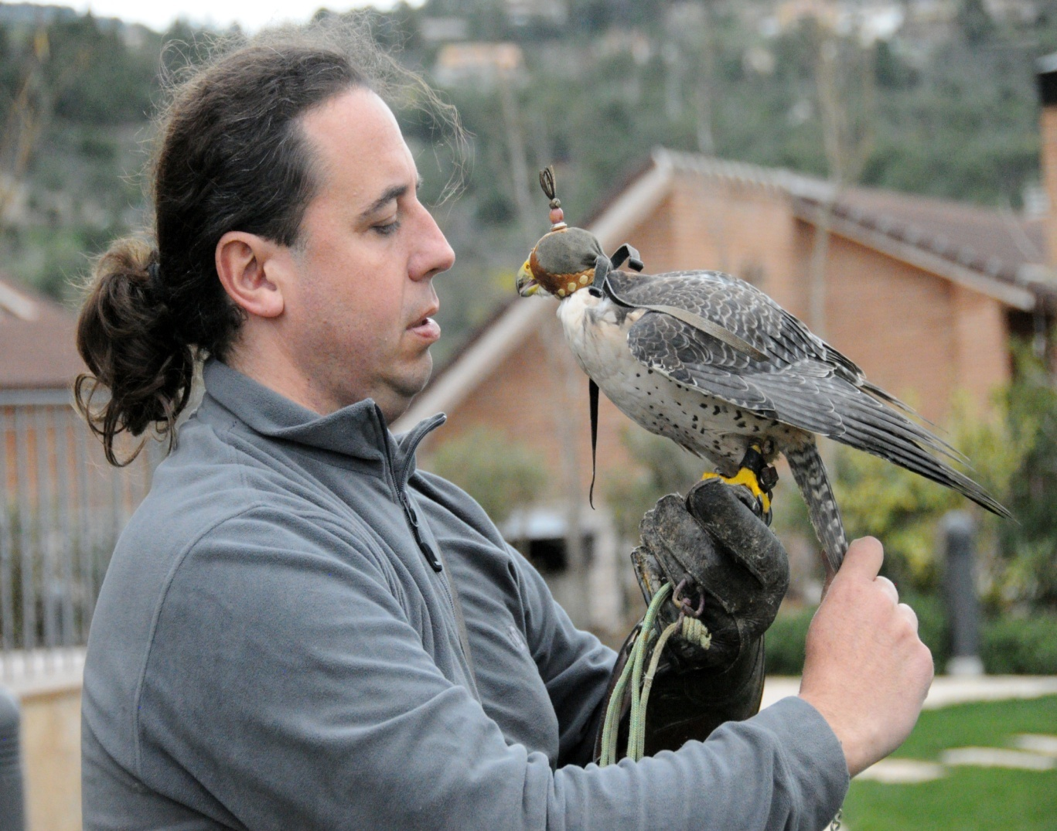
ACTIVITIES WITH CHILDREN
We have an interesting offer for children’s leisure, because they can enjoy donkey riding or even watching a bird exhibition. Apart from other activities you can get from our website.

Slide 10
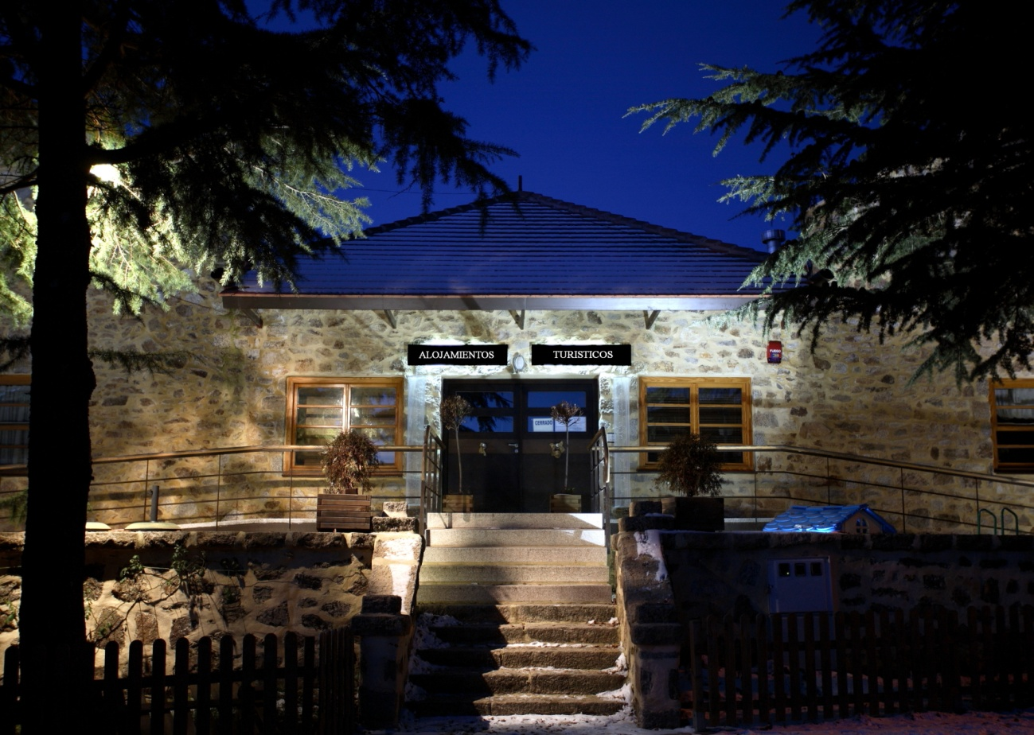
LEISURE FACILITIES
This town has several parks equipped with tables and benches, where to picnic with the family near the nicest paths, and also lovely cottages where to spend the night… if you don’t want to leave the town after a great day .

Slide 11
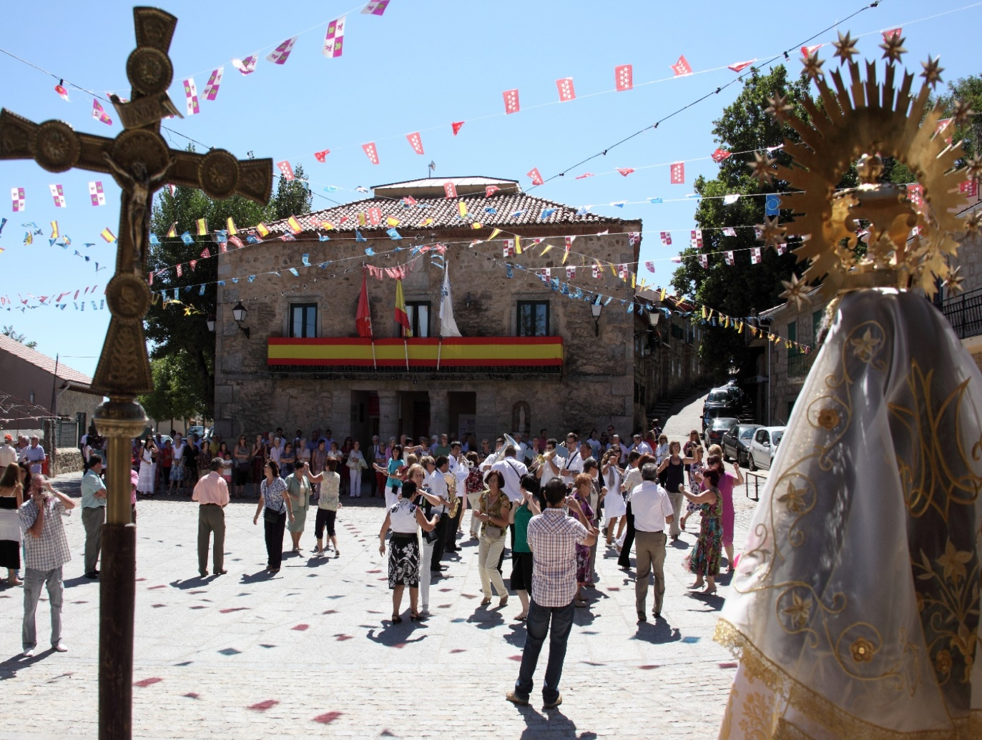
FESTIVITIES
Keeping traditions alive is one of the most important things
in small communities like this, and people enjoy festivities all together .

Slide 12
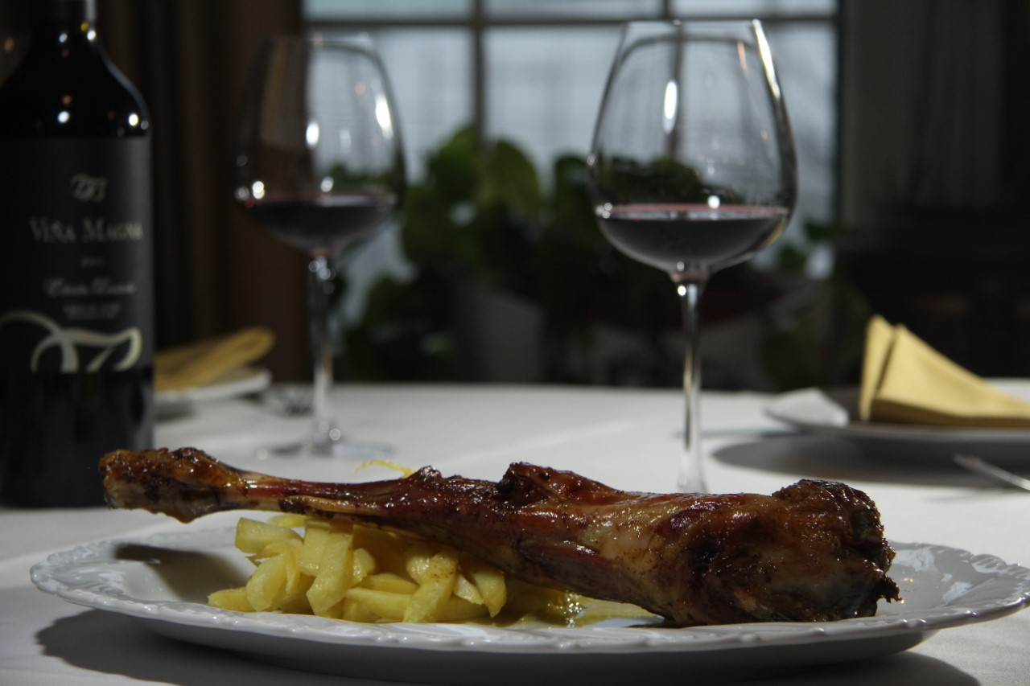
GASTRONOMY
One of the strengths of local economy is gastronomy. Due to the mountains of broad pastures, one of the most popular products in the restaurants is veal meat.
It is so tasty that it doesn´t need anything else.
And another very known dish is the one down here on the picture: “Patatas Revolconas”.
You shouldn’t miss the oportuntity to taste this ones.

Slide 13
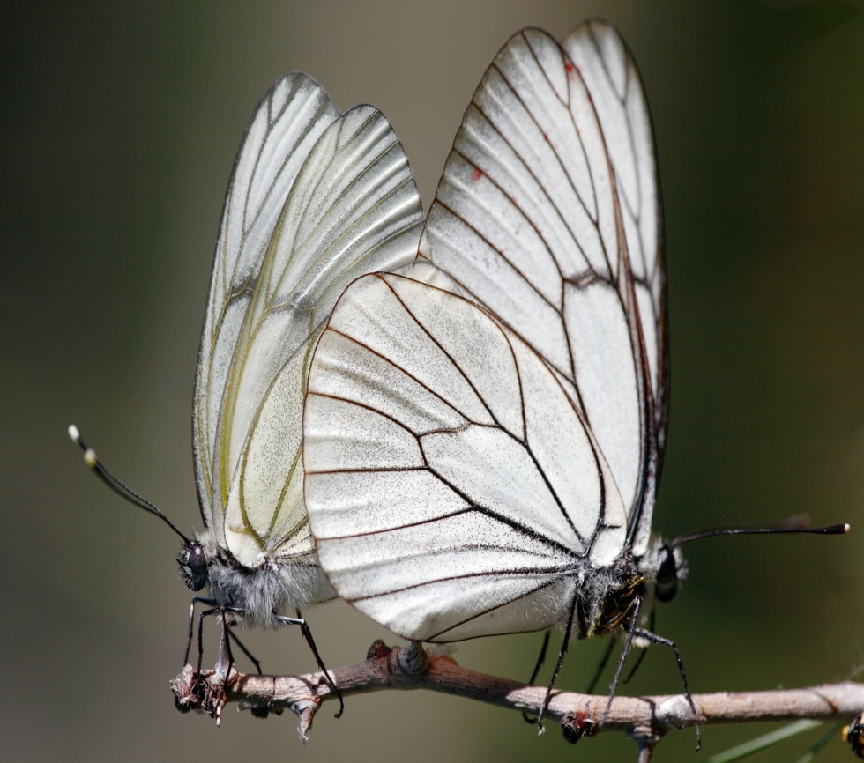
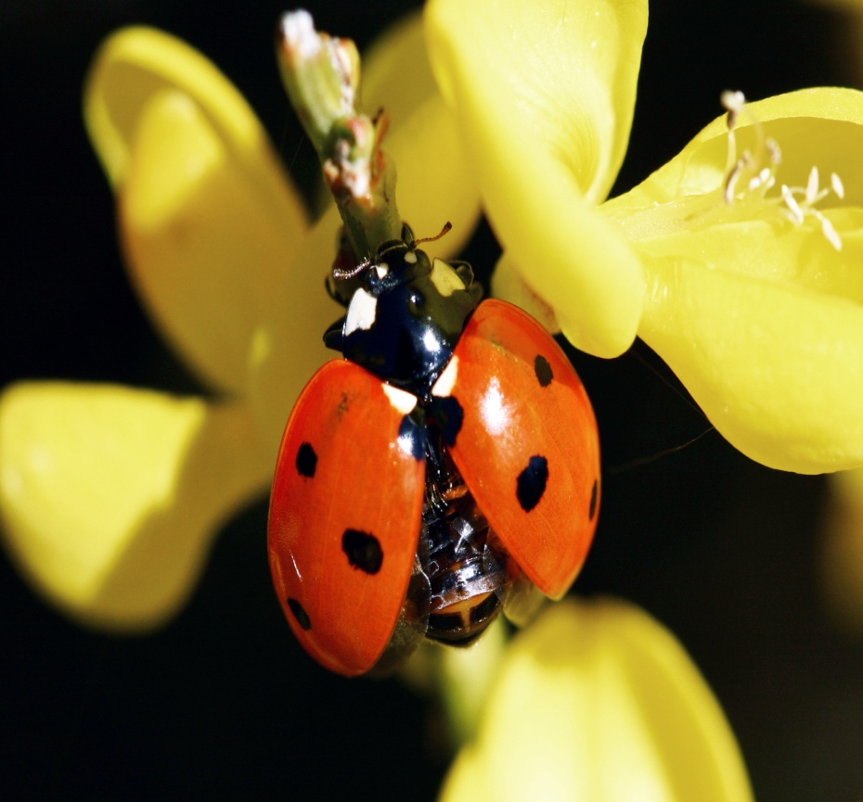
INSECTS
Some insects, like the rare butterfly Appollo, can be found on the top of the mountains.

Slide 14
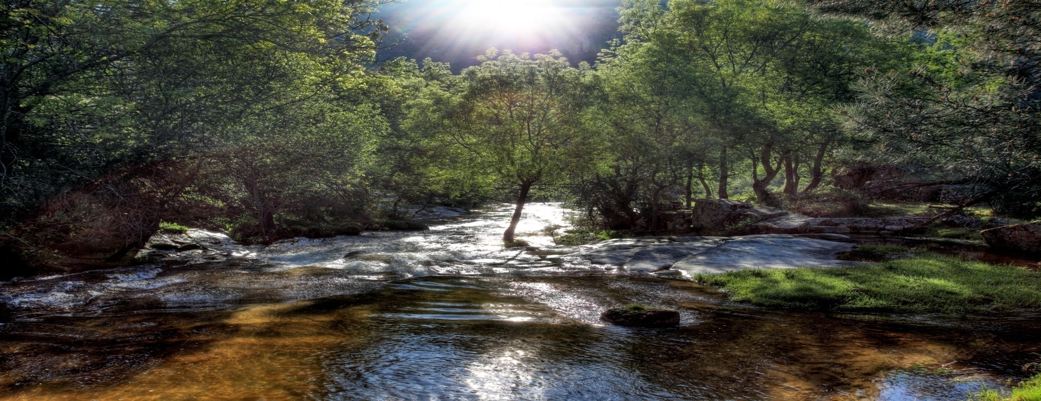
THE FAREWELL
If you don’t know yet where to spend your summer holidays, I hope that has helped you to take a decision. See you soon in Santa María de la Alameda!

